Slide 1


Artificial intelligence & Software Project Management
SAIRA SAEED
BSCS-F19-M-47
SECTION B MORNING
MAM AYESHA

Slide 2

introduction
Project management
planning and assessment
great signiﬁcance in project performance activities.
Artificial Intelligence
Growing industry.
Can be used as a SPM supporting tool.

Slide 3

background
Name | Year | Problem | Method | Conclusion
Francisco Herrera | 10 January 2008 | Software Engineering issues | Genetic Algo | They can deal with complex engineering problems which are difﬁcult to solve by classical methods
Önder Halis Bettemir | 29 July 2016 | Time-cost trade-off problem | heuristic, and meta-heuristic algorithms | The proposed heuristic algorithm is a convenient optimization method for the solution of time-cost trade-off problem.
Hadeel Alsolai | March 2020 | software maintainability prediction | The review uses the standard systematic literature review from January 1991 to July 2018. | The results indicate that there is relatively little activity in the area of software maintainability prediction compared with other software quality attributes.

Slide 4
Name | Year | Problem | Method | Conclusion
Nazakat Ali | August 30, 2019 | Evolution of an Software Product Line | Data mining and machine learning algorithm | machine learning algorithms have the capacity to identify relevant information automatically. Data mining also help to evolve the SPL
Min-Yuan Cheng | December 2012 | assessing project success | AI approaches including K-means Clustering, Genetic Algorithm (GA), Fuzzy Logic (FL), and Neural Network (NN). | Results show that EFNIM is able to estimate the degree of project success well and case clustering can greatly enhance project success assessments.

Slide 5


Methodology
Author review a large number of learning techniques aimed at project management.
Computational models of blended learning techniques

Slide 6

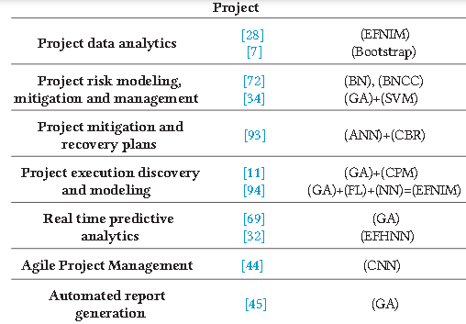
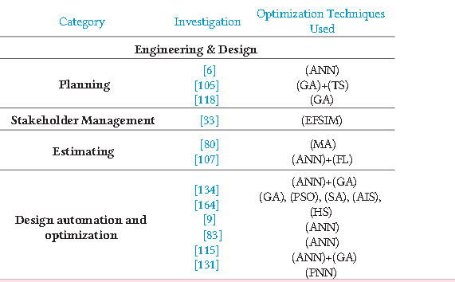
discussion

Slide 7

conclusion
The literary analysis concluded that extensive study in software project management on ML methods was done. The spread of jobs over the years has been continuous. ANN,
Fuzzy Logic, Genetic, and Regression Algorithms are the critical ML methods of automatic effort estimation.
The literature on SPM explains the performance of projects and loss

Slide 8

Thank you for your attention

